Slide 1

CH 42010: PROCESS PLANT OPERATION & SAFETY
LTP: 3-0-0, CRD: 3
Lecture 7
Plant Systems for Utilities & Auxiliary Services

Slide 2
CHEMICAL PROCESS UTILITIES
Apart from raw materials, chemical process industries and specially the manufacturing unit requires essential services to smoothly carry out a process which converts the raw materials into products.
These services are called utilities, which aid to the maintaining the desired operating conditions for the manufacturing of finished products.
Broadly utilities can be classified as the system required to provide air, water, and electricity, to the unit.
Major utilities required for typical chemical/production industry are:
Boilers
Compressors
Condensers, Refrigeration, Air Conditioning
Water Treatment Plants
Cooling Towers
Turbines
Air, Water, Fuel, Furnace, Insulation etc.

Slide 3
CHEMICAL PROCESS UTILITIES
Utilities can also pose serious economical and technical ill effects if not engineered well.
Increasing demand of water and fuels, increases the cost of the utilities required.
Proper understanding related to the consumption and management of utilities is essential.
Examples:
If a very high pressure steam is supplied to the HXs, which is not designed to handle them, will eventually damage it.
When a transformer works under load or overload, the energy losses are high. Efficiency will be maximum when the iron loss (eddy currents and hysteresis loss) equals to the copper loss (current dependent loss).
Generally, Cost to Utility = Generation Cost + Transmission Cost
Sometimes, depreciation and capital recovery cost is also added to it. If the utility is outsourced, then this is cost is simply added as material (water, air, gas, fuel, electricity etc.) cost to the project.
Optimization and utility calculation (heating and cooling) is measured by
PINCH ANALYSIS.

Slide 4
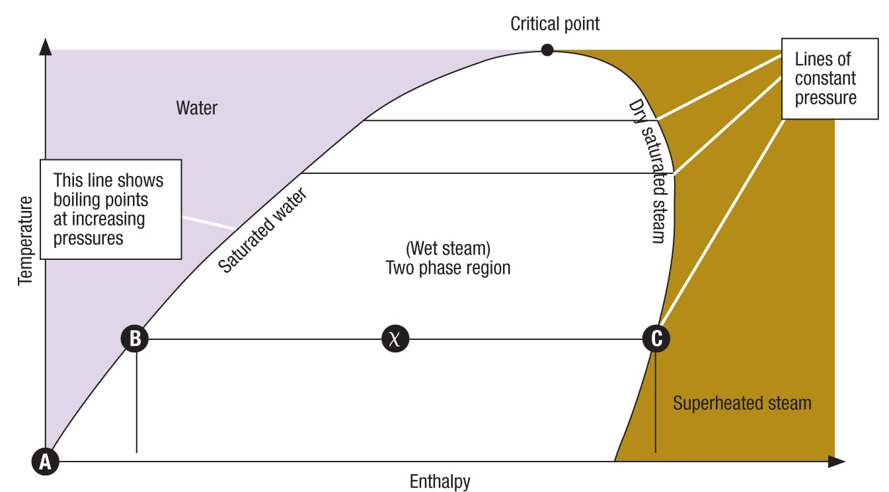
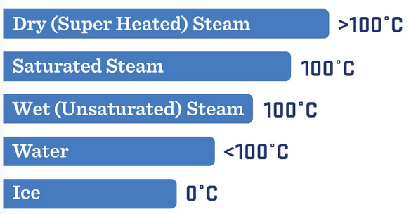
STEAM GENERATION AND DISTRIBUTION
Steam has been a popular mode of conveying energy since the industrial revolution.
Steam is used for generating power and also used in process industries such as sugar, paper, fertilizer, refineries, petrochemicals, chemical, food, synthetic fibre and textiles.
The following characteristics of steam make it so popular and useful to the industry:
Highest specific heat and latent heat
Highest heat transfer coefficient
Easy to control and distribute
Cheap and inert
Source: Google Images

Slide 5
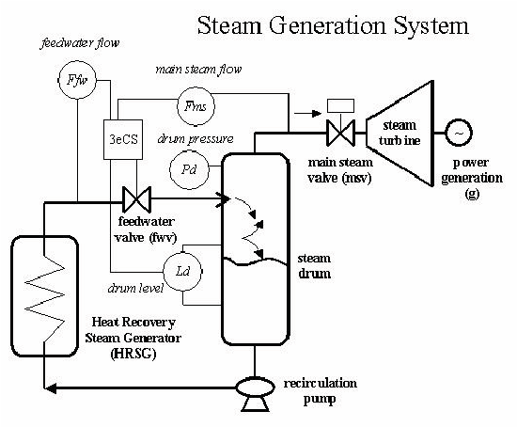
STEAM GENERATION
Plant Steam (Utility Steam)
Plant steam, or utility steam, is “typical” for industrial steam generation systems.
It can be at a variety of pressures, but is typically saturated.
Plant steam usually has boiler chemicals or additives to prevent corrosion, so in many cases, it cannot be directly added to products.
Utility steam is sometimes referred to by the pressure it’s distributed at: either low, medium, or high pressure steam.
The exact pressure of each of these will vary at different locations and industries.
Source: Google Images

Slide 6
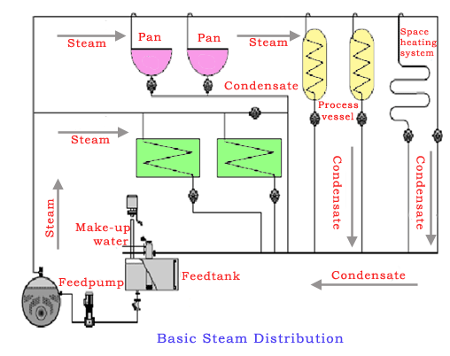
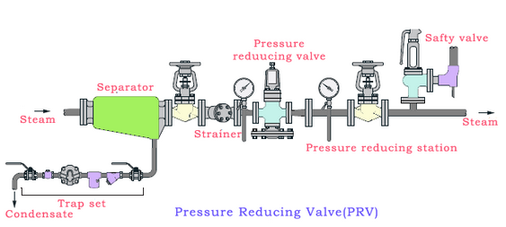
STEAM DISTRIBUTION SYSTEM (SDS)
Design of SDS
Steam-generating working pressure: Maximum pressure at which the boiler or the co-generation plant can produce steam. It depends on the type and capacity of the boiler, the fuel used, and the process requirements.
Minimum pressure requirement at process end: Minimum pressure at which the steam-consuming equipment can operate efficiently and safely. It depends on the type and capacity of the equipment, the process conditions, and the safety margins.
Pressure loss in SDS: This is the difference between the steam-generating pressure and the process pressure. It is caused by frictional resistance in the pipes and fittings, condensation in the pipes due to heat transfer to the surroundings, and pressure-reducing valves (PRVs) if used.
Steam quality: Measures how dry and saturated the steam is. It depends on the boiler’s design, operation, and maintenance, plus the condensate removal system. Poor steam quality can cause wet steam, leading to erosion, corrosion, water hammer, reduced heat transfer efficiency, and equipment damage.
Source: Google Images

Slide 7
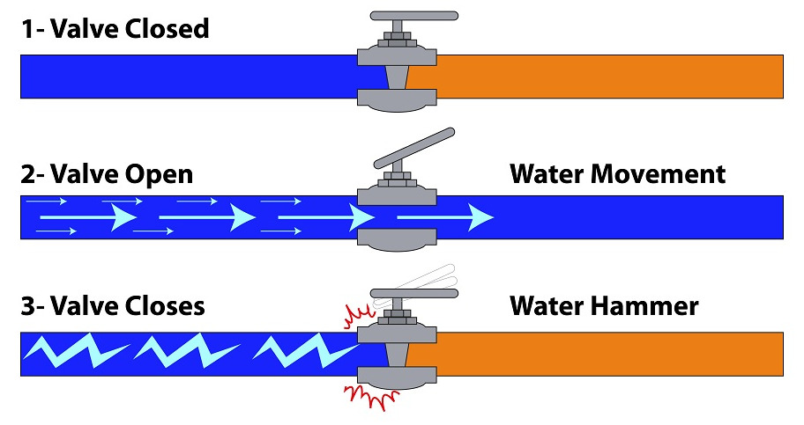
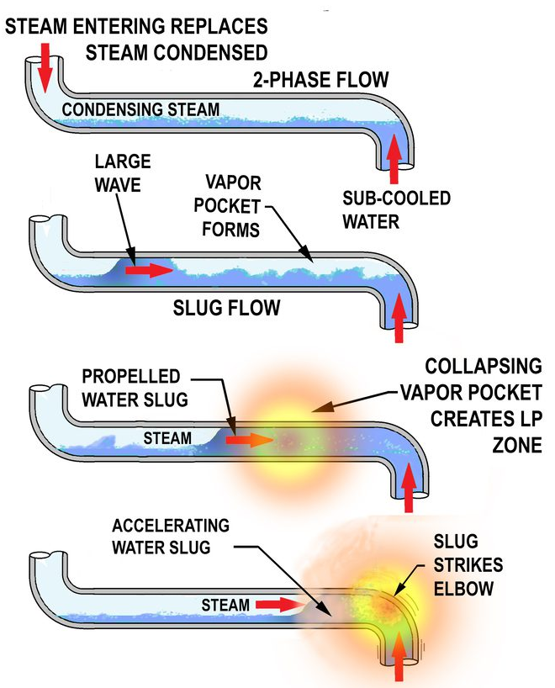
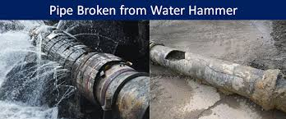
WATER & STEAM HAMMERING
WATER HAMMERING
STEAM TRAPS
For example, a 100 mm well lagged pipe of 30 m length carrying steam at 7 kg/cm² pressure can condense nearly 10 kg of water in the pipe in 1 hour.
The problem of water hammer can be eliminated by positioning the pipes so that there is a continuous slope in the direction of flow. A slope of at least 12 mm in every 3 m is necessary, as also an adequate number of drain points every 30 to 50 m.
STEAM HAMMERING
Source: Google Images

Slide 8
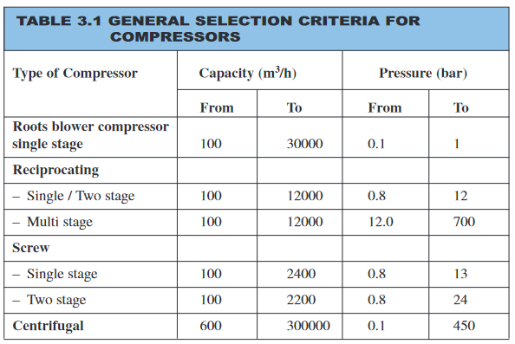
COMPRESSED AIR SYSTEM (CAS)
Capacity of a Compressor
It is the full rated volume of flow of gas compressed and delivered at conditions of total temperature, total pressure, and composition prevailing at the compressor inlet.
It sometimes means actual flow rate, rather than rated volume of flow.
This also termed as Free Air Delivery (FAD) i.e. air at atmospheric conditions at any specific location. Because the altitude, barometer, and temperature may vary at different localities and at different times, it follows that this term does not mean air under identical or standard conditions.
Compressor Efficiency Definitions
Several different measures of compressor efficiency are commonly used:
Volumetric efficiency
Adiabatic efficiency
Isothermal efficiency
Mechanical efficiency
Most Common are: Isothermal efficiency & Volumetric efficiency
Source: Google Images

Slide 9
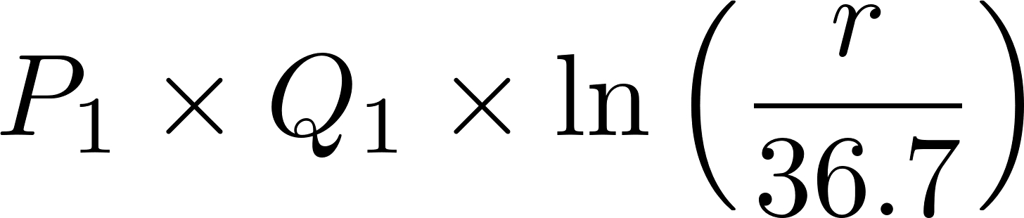
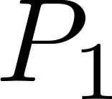
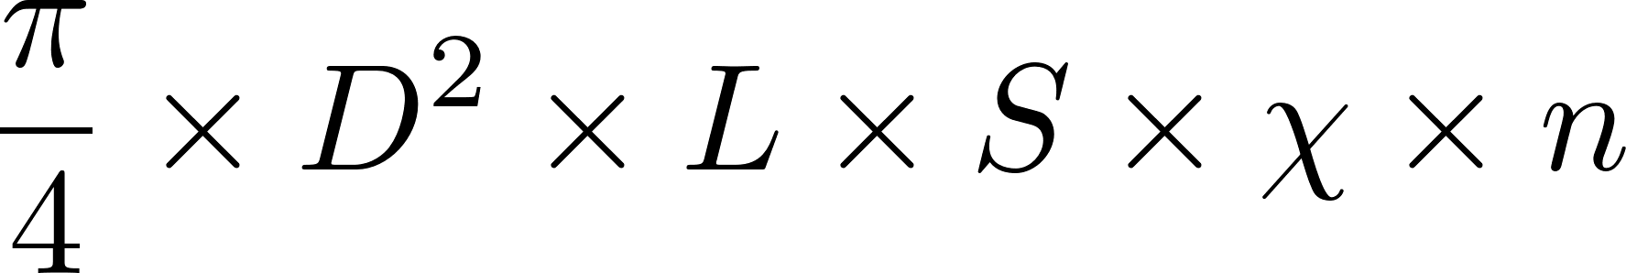
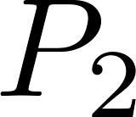

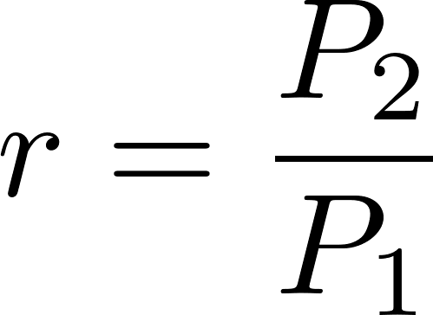

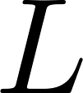


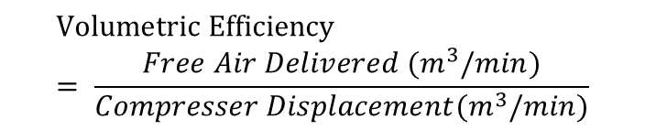
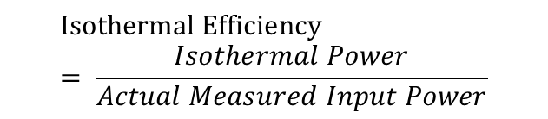
COMPRESSED AIR SYSTEM (CAS)
Isothermal Efficiency
Volumetric Efficiency
$$Isothermal Efficiency= \frac{Isothermal Power}{Actual Measured Input Power}$$
$$Volumetric Efficiency= \frac{Free Air Delivered (m^{3}/min)}{Compresser Displacement(m^{3}/min)}$$
Isothermal Power (in kW) =
Compressor displacement =
Absolute intake pressure (kg/cm²) =
Absolute delivery pressure (kg/cm²) =
Free air delivered (m³/hr) =
Cylinder bore (m) =
Pressure ratio =
Cylinder stroke (m) =
Compressor speed (rpm) =
Important: The calculation of isothermal power does not include power needed to overcome friction and generally gives an efficiency that is lower than adiabatic efficiency. The reported value of efficiency is normally the isothermal efficiency. This is an important consideration when selecting compressors based on reported values of efficiency.
Number of cylinders =
Type of cylinders =

Slide 10
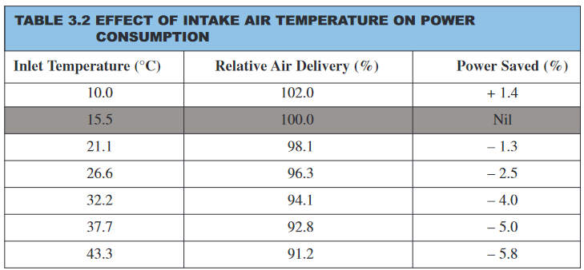
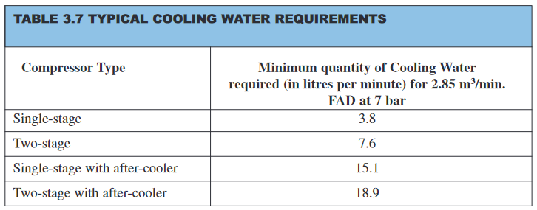
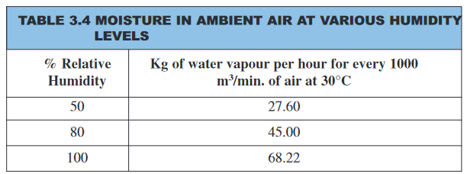
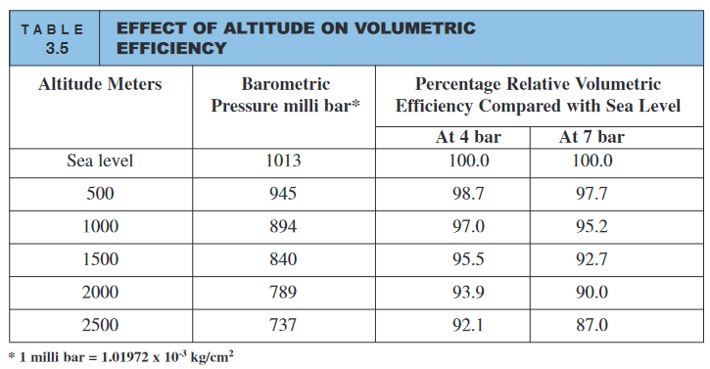
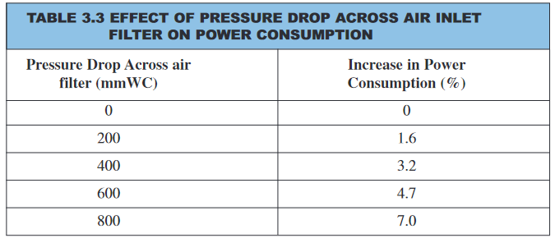
EFFICIENT OPERATION OF CAS

Slide 11
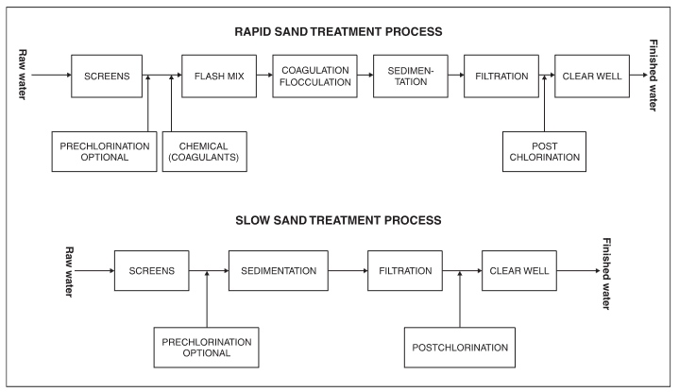
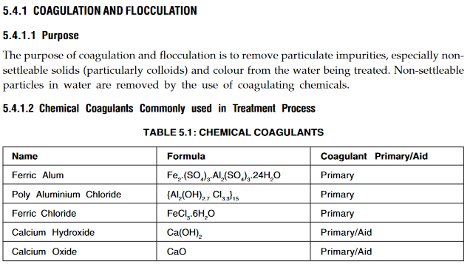
WATER SUPPLY & TREATMENT
Discuss more about it in the upcoming lectures !!!
Source: Google Images

Slide 12
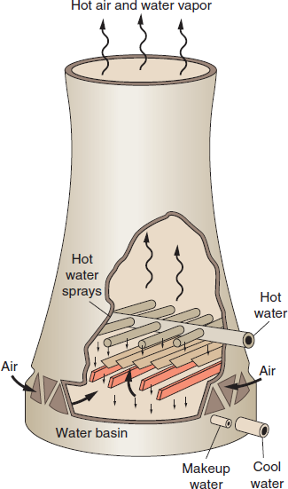
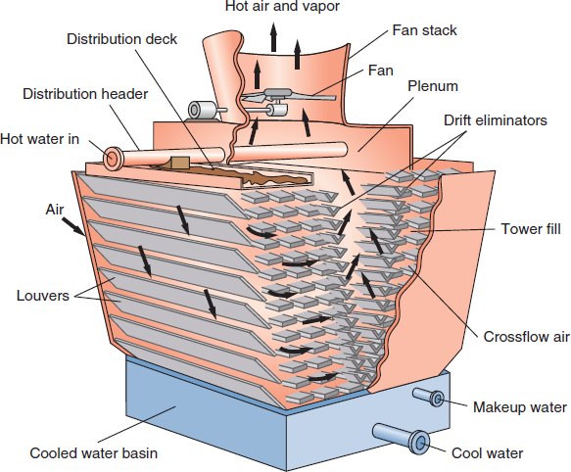
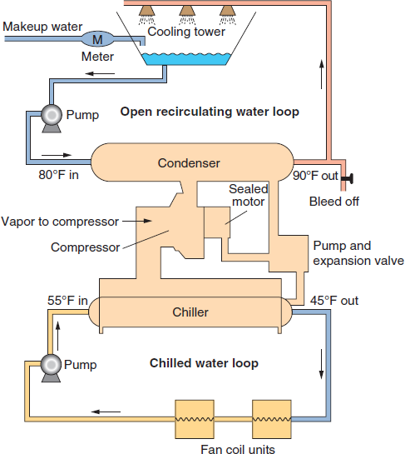
COOLING SYSTEMS
Cooling tower with induced draft
Components of a complete air conditioning system
Hyperbolic cooling tower with natural draft
Source: Google Images

Slide 13
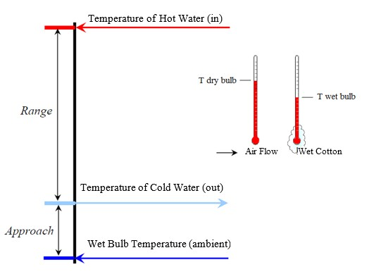
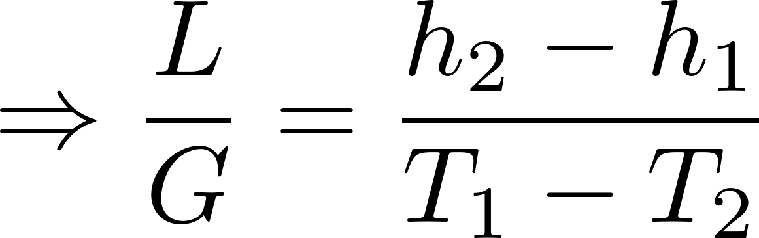
COOLING TOWER (CT)
CT Range = CT inlet water temperature – CT outlet water temperature
CT Approach = Cold Water Temperature – Ambient Wet Bulb Temperature
Make up water Requirement in m³/hr (M) = Evaporation Loss in m³/hr (E) + Drift Loss in m³/hr (D) + Blow Down in m³/hr (B)
Cycles of concentration (C.O.C) = Dissolved solids in circulating water / Dissolved solids in make up water
Evaporation Loss (m³/hr) = 0.001 × circulation rate (m³/hr) × (T₁-T₂); T₁-T₂ = Temp. difference b/w inlet & outlet water.
Blow Down = Evaporation Loss / (C.O.C. – 1)
Cooling Tower Efficiency = (Hot Water Temp. – Cold Water Temp.) × 100/(Hot Water Temp. – Wet Bulb Temp.)
Cooling Tower Efficiency = Range/ (Range + Approach) × 100
L/G Ratio
T₁ = hot water temperature (°C) (°F);
T₂ = cold water temperature (°C) (°F);
h₂ = enthalpy of air-water vapor mixture at exhaust wet-bulb temperature (Btu/lb);
h₁ = enthalpy of air-water vapor mixture at inlet wet-bulb temperature (Btu/lb)
L/G = liquid to gas mass flow ratio
Source: Google Images

Slide 14
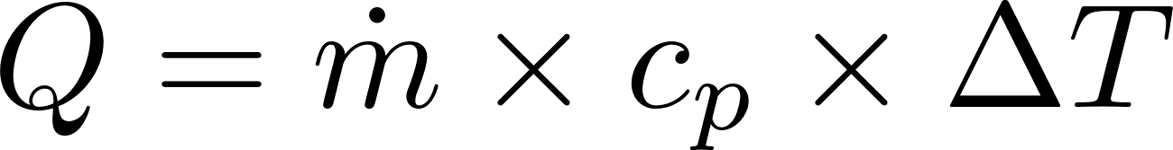
COOLING TOWER (CT)
Q1. A CT cools 1000 lpm from 95°C to 85°C at 72°C wet bulb temperature and operates at 3 cycles of concentration. Calculate Range, Approach, Heat Rejection, Drift Loss, Evaporation Loss, Bleed Rate and Make-up water requirements. Assume drift loss to be 0.2%.
1. Range: (HWT – CWT) =
2. Approach: (CWT – WBT) =
3. Heat Rejection (in kW):
4. Drift Loss: (0.002 × Flow Rate) =
5. Evaporation Loss: 0.001 × Range × Circulation rate =
6. Bleed Rate/Blow Down: (Evaporation Loss / (Cycles-1) =
7. Make-up Requirements: Drift Loss + Evaporation Loss + Bleed Rate =

Slide 15
COOLING TOWER (CT)
Q1. A CT cools 1000 lpm from 95°C to 85°C at 72°C wet bulb temperature and operates at 3 cycles of concentration. Calculate Range, Approach, Heat Rejection, Drift Loss, Evaporation Loss, Bleed Rate and Make-up water requirements. Assume drift loss to be 0.2%.
1. Range: (HWT – CWT) = 95 - 85 = 10°C
2. Approach: (CWT – WBT) = 85 - 72 = 13°C
3. Heat Rejection:
4. Drift Loss: (0.002 × Flow Rate) = 0.002 × 1000 = 2 lpm
5. Evaporation Loss: 0.001 × Range × Circulation rate = 0.001 × 10 × 1000 = 10 lpm
6. Bleed Rate/Blow Down: (Evaporation Loss / (Cycles-1) = 10 / (3-1) = 5 lpm
7. Make-up Requirements: Drift Loss + Evaporation Loss + Bleed Rate = 2 + 10 + 5 = 17 lpm

Slide 16
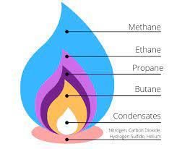
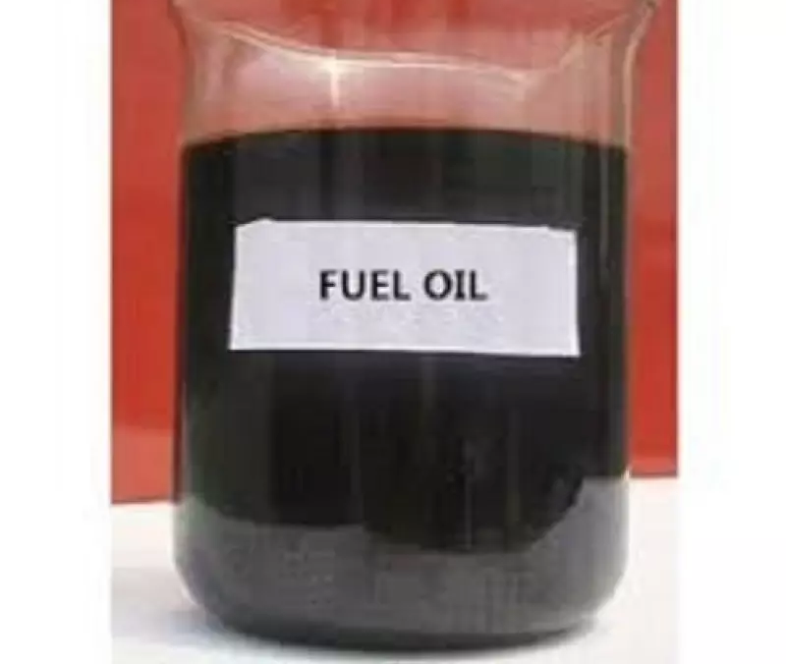
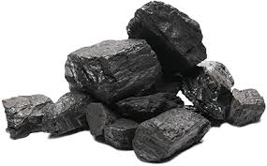

FUEL & LUBRICATION SYSTEMS
FUEL SYSTEMS
Types of Fuels
Natural Gas
Oil
Solid Fuels
Alternative Fuels
Composition: Methane (primary)
Applications: Industrial burners, turbines, heaters
Types: Heavy fuel oil (HFO), light fuel oil (LFO), and diesel
Applications: Engines, boilers, and backup generators
Examples: Coal, biomass.
Applications: Specific applications & environmental considerations.
Examples: Hydrogen, biodiesel, and synthetic fuels.
Applications: Emerging trends and sustainability.
Source: Google Images

Slide 17
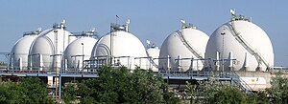
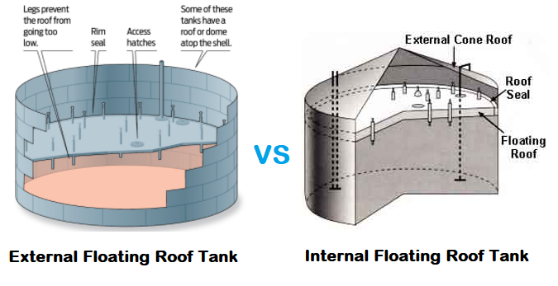
FUEL & LUBRICATION SYSTEMS
Fixed roof tanks are used for liquids with very high flash points (e.g., fuel oil, bitumen).
Cone roofs, dome roofs and umbrella roofs are usual.
These tanks may be insulated and heated with steam coils to prevent the product to become too viscous, thus plugging pipework and becoming potentially unpumpable.
Dome roof tanks are meant for tanks having slightly higher-than-atmospheric storage pressure (e.g., slop oil).
Liquefied gases (such as LPG, butane, propylene, etc.) may be stored in spherical tanks (or Horton spheres).
Floating roof tanks are broadly divided into external floating roof tanks (usually referred to simply as floating roof tanks, or FR tanks) and internal floating roof types (IFR Tanks).
IFR tanks are used for liquids with lower flash points (e.g., jet fuel, petrol, ethanol).
They are essentially cone-roof tanks with an internal floating roof travelling vertically up and down along with the liquid level. This floating roof traps the vapour from low flash-point fuels.
Floating roofs are supported with legs or cables on which they rest. FR tanks do not have a fixed roof, being open at the top, and have a floating roof only.
Medium flash point liquids such as naphtha, kerosene, diesel, and crude oil are stored in these tanks.
Source: Google Images

Slide 18
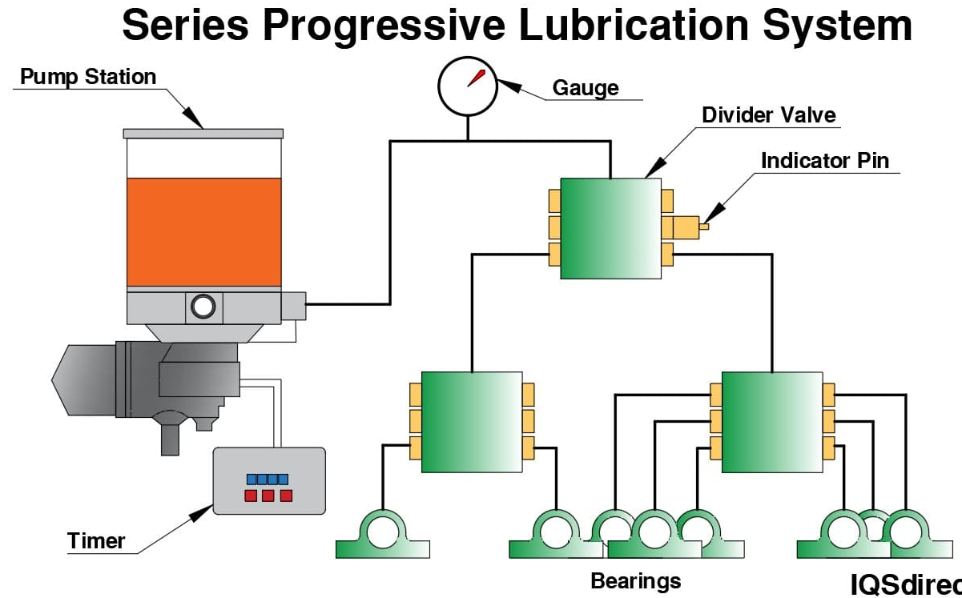
FUEL & LUBRICATION SYSTEMS
LUBRICATION SYSTEMS
Principles of Lubrication:
Purpose: Minimize friction, reduce wear, and prevent overheating.
Lubricant types:
Liquid (oil), semi-solid (grease), and solid (graphite).
Selection criteria based on temperature, load, and speed.
Components of Lubrication Systems:
Pumps and reservoirs.
Filters and strainers.
Valves and distribution systems (e.g., single-line, dual-line, and circulating systems).
Types of Lubrication Systems:
Manual Lubrication: Grease guns, oil cans.
Automatic Lubrication: Centralized systems for bearings, gears, and chains.
Circulating Systems: Used in turbines, compressors, and large machinery.
Maintenance of Lubrication Systems:
Checking lubricant levels and quality.
Detecting contamination and degradation (e.g., particle analysis, viscosity measurement).
Replacing filters and cleaning systems.
Reliability Considerations:
Impact of improper lubrication: Increased downtime, excessive wear, and energy loss.
Predictive maintenance using tools like vibration analysis and thermography.
Source: Google Images

Slide 19
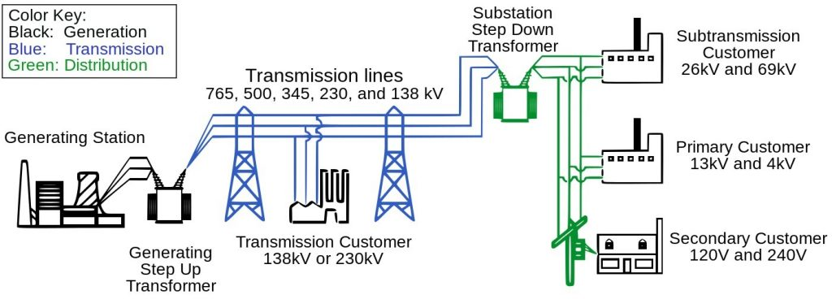
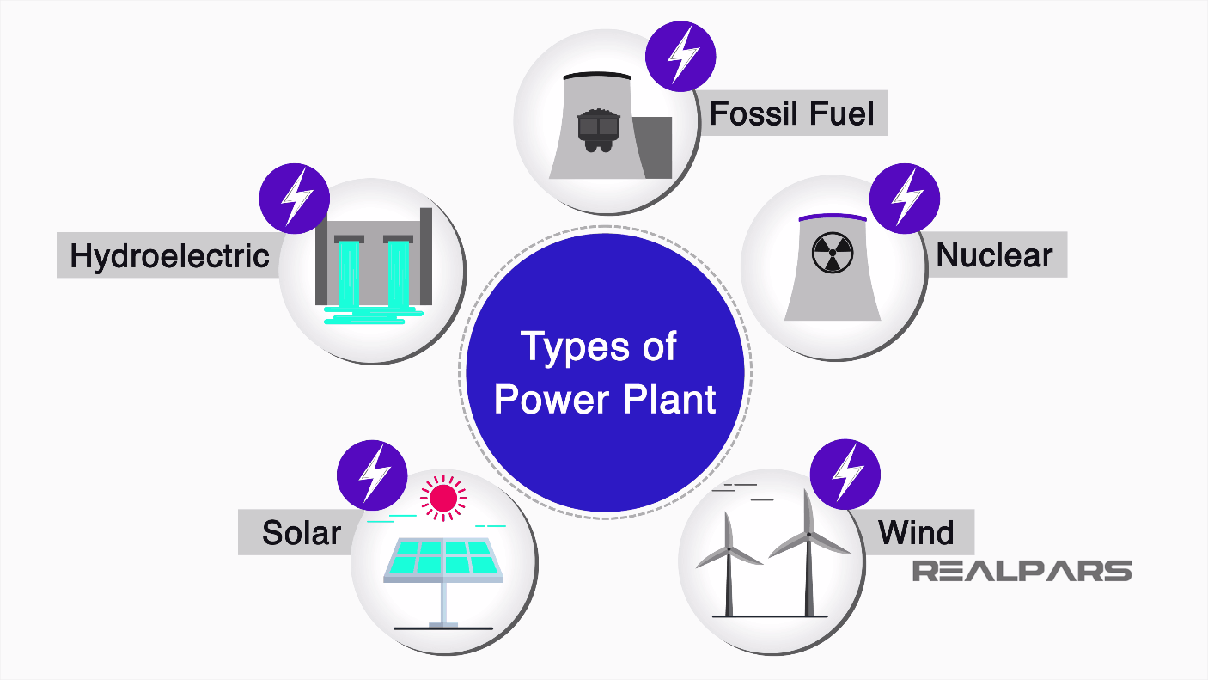
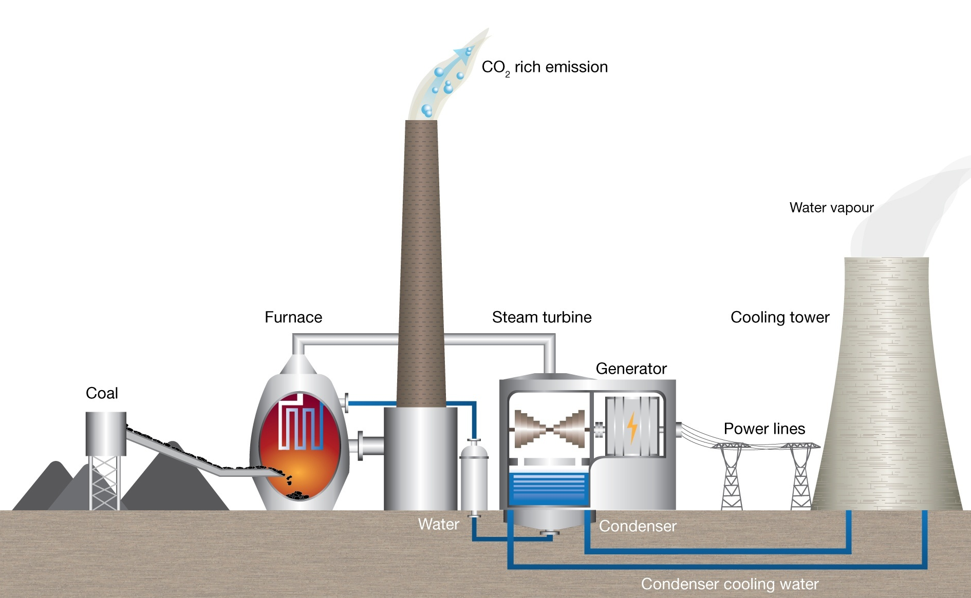
ELECTRICAL POWER SYSTEMS
Coal-fired power station
About 70 % of power generating capacity in India is from coal based thermal power plants.
Coal is pulverized to the consistency of talcum powder.
Then powdered coal is blown into the water wall boiler where it is burned at temperature higher than 1300°C.
The heat in the combustion gas is transferred into steam.
This high-pressure steam is used to run the steam turbine to spin.
Finally turbine rotates the generator to produce electricity.
Source: Google Images

Slide 20
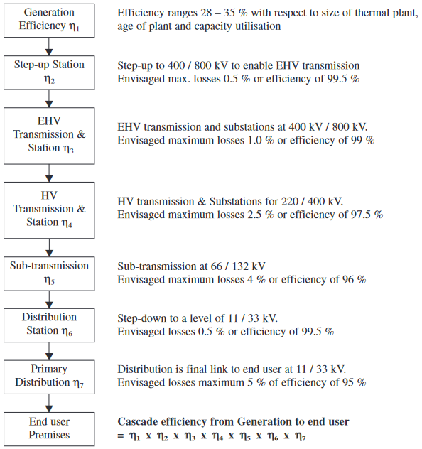
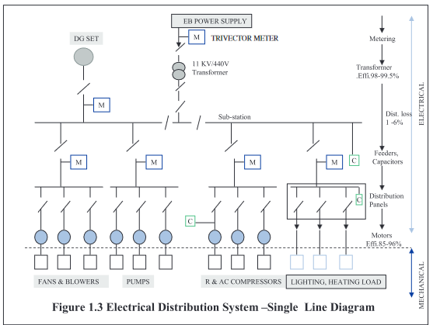
ELECTRICAL POWER SYSTEMS
POWER TRANSMISSION SYSTEMS
The standard technical losses are around 17 % in India (Efficiency = 83%). But the figures for many of the states show T & D losses ranging from 17 – 50 %.
Source: Google Images

Slide 21
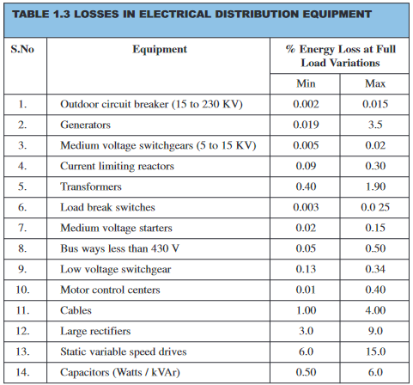
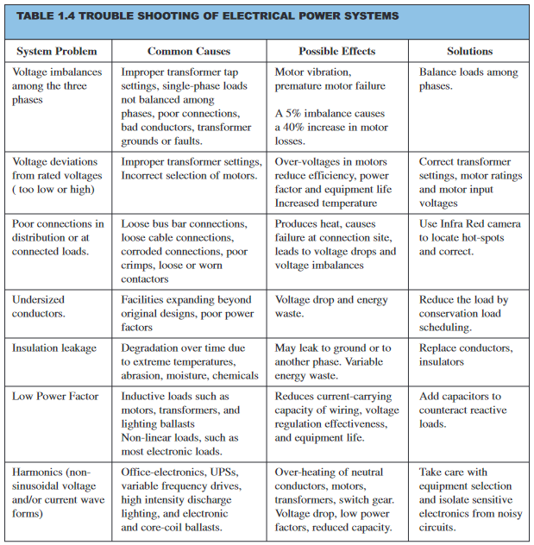
ELECTRICAL POWER SYSTEMS
Source: Google Images

